Slide 1

Welcome to A-State!
New Employee Orientation
Cathy Naylor
Training & Development Coordinator
cnaylor@AState.edu

Slide 2
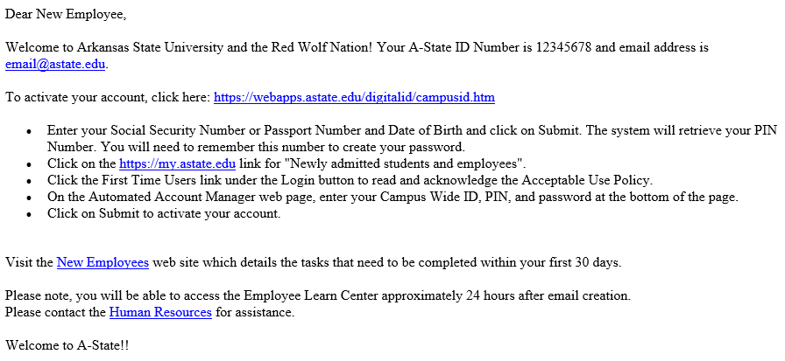
A-State Account Notification

Slide 3
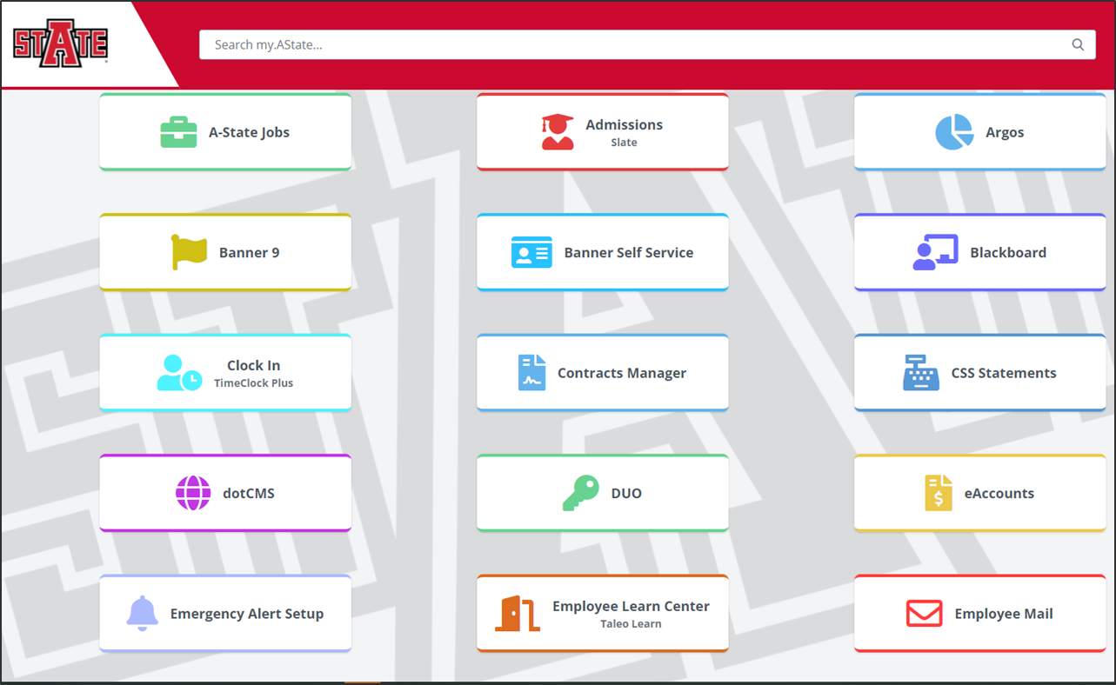
My.AState.edu Portal

Slide 4
My.Astate.edu Portal
Duo Login
Blackboard Learn
Employee Learn Center
Parking eBiz
Banner Self Service
Pack Support
Concur – Travel
Manage Timesheets
Employee e-mail

Slide 5
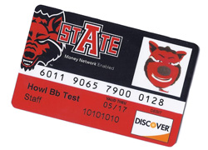
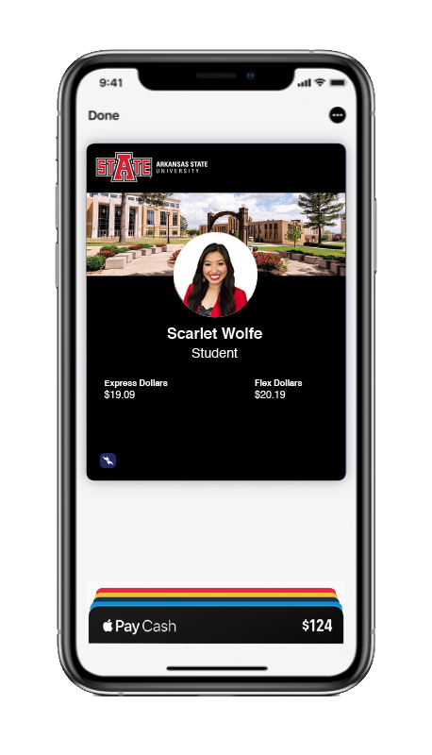
ID Card
Campus Card Center – Library 1st Floor
Uses:
Library for Checking out Books, DVD’s, etc.
Hotels – State Employee Discount may be available
25% Discount at Textbook Brokers
Local Restaurants and Stores
Reserved parking lots on Campus
Access to buildings
Cafeteria Plan
  15 Meals for $75
  Payroll deduction

Slide 6
Parking Overview
Must purchase a Parking Permit if parking a vehicle on campus
Permits can be transferred as long as vehicle is registered
Permits are for August to August each year
Payroll Deduction
Parking Options:
$90 Faculty/Staff Parking
$70 Staff/Employee Parking permit
Visit Parking Services web page to view maps for parking options in your area
Reserved spaces available and assigned through Parking Services.
$500 for covered garage spaces
$300 for all other reserved spaces

Slide 7


Ordering Parking Permit
Log in to my.AState
Click on Parking eBiz icon
Print temporary parking pass
Employees must order new permit each school year
Permits are from August to August

Slide 8
Payroll
Pay Day
  Semi-monthly
  15th and last day of each month
  If either falls on a weekend, payroll deposits will be issued on the Friday before
  Retirement deduction begins with your first pay check
Vacation and Sick Leave
  Vacation Leave: earn 15 hours per month (12 month faculty only)
    Can carry over 240 hours each year
  Sick Leave: earn 8 hours of sick leave per month
    Can carry over 960 hours each year
    You can view your balances by logging in to my.AState then click on your Banner Self Service icon.

Slide 9
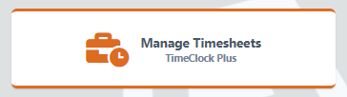
TimeClock Plus
Access through my.AState
  TimeClock Plus for Managers
Non-exempt: eligible to earn overtime
  Overtime = Compensatory Hours
  Supervisor must be aware of any overtime earned
User guides available on Payroll Services webpage
TimeClock Plus Coordinator – Kimberly Smith

Slide 10
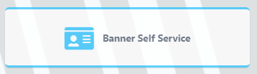
Banner Self Service
Viewing Paystub
Viewing Leave Balances
Submitting Leave Report
Viewing W-2 and 1095-C
  Consent to receive electronically
Update personal information
  Update address and phone number
  Emergency Contacts

Slide 11
Benefits

Slide 12
Benefits
Receive email from Kristin Helms
Complete enrollment/waiver within 30 days of hire
Complete by August 31 to be effective September 1
Failure to enroll:
  Classic Plan - Employee Only Health Insurance (12 month employee pays $53.00 a pay period)
  A-State Paid Life Insurance and Long Term Disability Insurance
  TIAA Retirement (employee contributes 6%, A-State contributes 10%)
Benefit Changes:
  Open Enrollment in November / Effective January
  Qualifying event: Marriage, Divorce, Birth/Adoption, Court Ordered Change

Slide 13
Employee Assistance Program
The St. Bernard’s Counseling Center EAP assists employees and their family members when dealing with problems that can occur in everyday life.
You can seek assistance in a simple and confidential manner from a trained professional.
Referrals to the EAP can be made by yourself, family members, supervisors or physicians, etc.
You will receive 6 free visits.

Slide 14
Additional Benefits
Dean B. Ellis Library
  Check out books, including popular selections
  Rent movies, audio books, board games
  ASU Museum
RedWolf Wellness Center
  Free membership for faculty, staff, and spouses
  Located in HPESS building
  Sign up for free membership at Wellness Center
Education OR Physical Fitness Leave (12 month faculty only)
  3 hours/week
  Must be approved by supervisor – form on HR webpage

Slide 15

Additional Benefits
Education Benefits
  Tuition Discount Program:
    Available for Bachelor and Graduate degrees at each campus and all online programs (check HR website for FAQs)
    Faculty, staff, spouses, and tax dependent children
    Submit Tuition Discount Form every semester
  Professional Development Plan Bonus
    Submit form with supervisor’s signature

Slide 16
Access/Training

Slide 17
A-State Account Notification

Slide 18
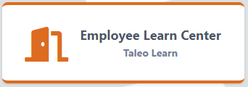
Employee Training Requirements
Required for ALL employees
Complete within 30 days
Taleo Learn
  Title IX (Sexual Discrimination)
  Child Maltreatment
  Privacy and Security
  FERPA
Access through My.Astate – Employee Learn Center icon

Slide 19
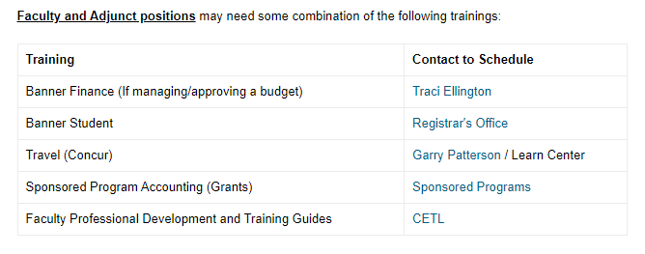
Additional Training Resources
Search “Training & Development”
Schedule directly with contact listed
Submit Banner Access Request to cpi-security@astate.edu

Slide 20
Tobacco Free Campus
The Arkansas Clean Air on Campus Act of 2009
No tobacco is allowed anywhere on campus
  Cigarettes
  Cigars
  Pipes
  Smokeless tobacco
  Vaping devices including e-cigarettes
Enforced by UPD
Fines from $100-$500

Slide 21
Drug Free Workplace
The Drug-Free Workplace Act of 1988
Annual notice can be found:
  On UPD webpage – Annual Security Report
  Emailed out to campus community from Student Conduct each October

Slide 22

Final Thoughts
Complete I-9 in Human Resources office
Pick up Welcome Box from me at lunch!

Slide 23

THANK YOU
&
WELCOME TO
ARKANSAS STATE UNIVERSITY
Human Resources: 870-972-3454
  Benefits: Kristin Helms
  TimeClock Plus: Kimberly Smith
Parking Services: 870-972-2945
Training Questions:
  Cathy Naylor: 870-680-8079

